Slide 1

Trivent
accountants & belastingadviseurs

Slide 2



Key data
Merger of 3 independent firms founded app. 25 years ago
Combined forces in 2015 en 2018 (KRP, member of CHI)
Approximately 60 professionals (7 partners) in accounting, tax advisory, corporate finance and auditing.
In 3 locations in Eindhoven-, ‘s-Hertogenbosch- and Tilburg-area

Slide 3
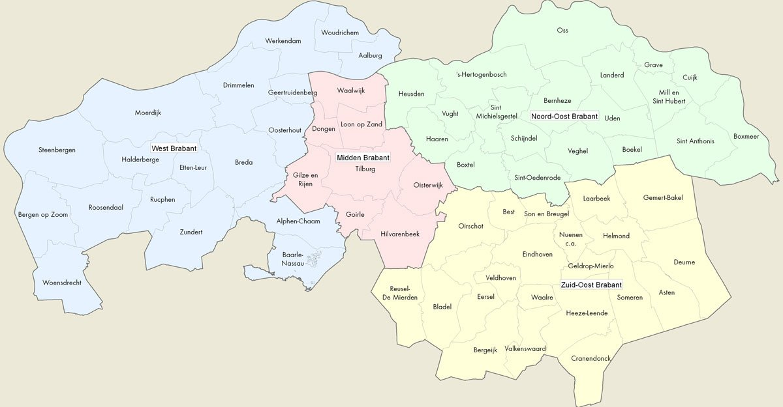


Slide 4

Rendering services to small and medium sized (often family owned) companies and their stakeholders in all kind of business, except for agricultural activities
Licensed by AFM to perform audits (mandatory for medium sized entities)
Member of NBA (professional organisation of CPA’s), SRA (370 high quality firms in accounting and advisory) and NOB (professional organisation of tax advisors)
Based in the south of the Netherlands and serving customers throughout the country and surrouding countries.

Slide 5
Our objectives
To excel in accounting, auditing, corporate finance and tax advisory by:
  Continuous development and training of our professionals
  Building bridges with our customers using sophisticated ICT solutions
  Using intelligent software solutions for data analyses and data exchange
To become the best employer for talented people by offering them excellent working conditions and facilities to develop themselves into top professionals
Double our size in terms of number of professionals employed and turnover within the next 10 years

Slide 6

Questions?
kantoor ‘s-Hertogenbosch kantoor Nuenen kantoor Waalwijk 088 374 23 74
Vughterweg 47j, 5211 CK ‘s-Hertogenbosch Collse Hoefdijk 16, 5674 VK Nuenen Zinkerweg 1, 5145 NL Waalwijk info@trivent.nl
Postbus 114, 5260 AC Vught Postbus 295, 5670 AG Nuenen Postbus 507, 5140 AM Waalwijk www.trivent.nl
t
e
w

